Slide 1

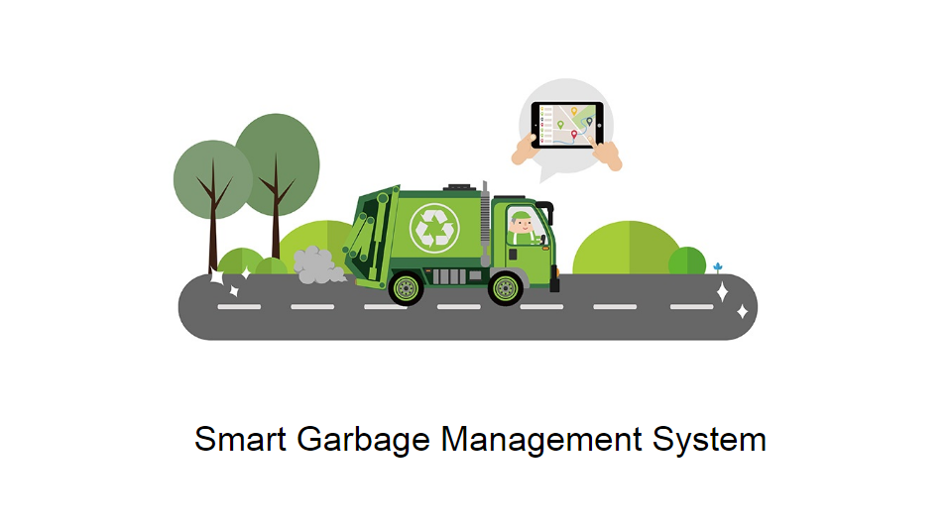
save Time…..
be Clean...
By: V.Diluxshan

Slide 2
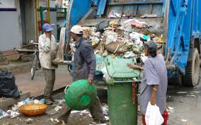
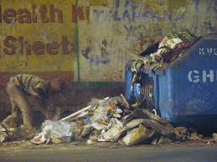
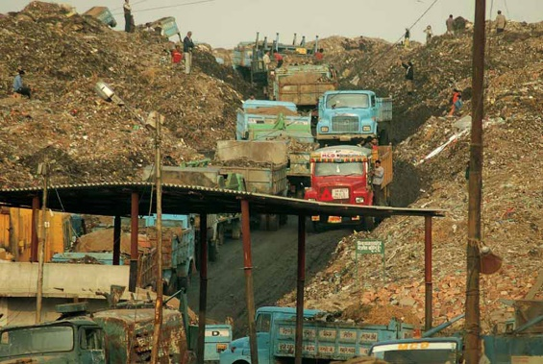
Current Waste Management System:
Trucks set out at a specific time on a set route everyday to collect waste irrespective of how full the bins are at the collection points.
Inefficient use of Manpower
Over flowing Bins
Fuel wastage due to bad routing and collection of unfilled bins.

Slide 3
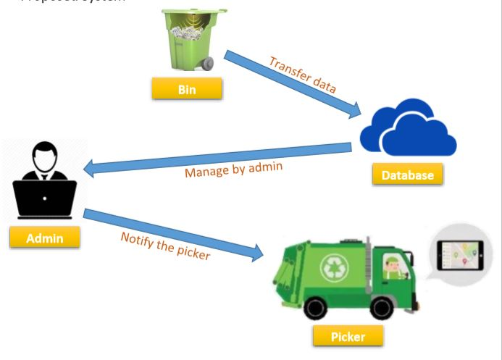
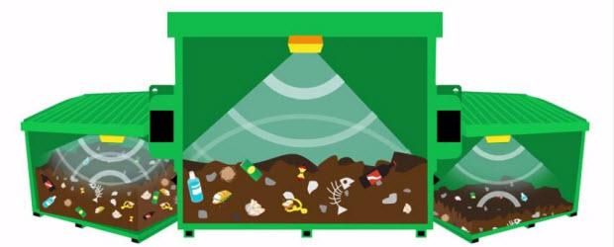
Our System:
90%
70%
30%
0%
Device (powered by battery)
Bin Level
Data is processed and mapped
Univeersity level
Vehicle routing algorithm
Routes and directs trucks based on their capacity and mileage.
Trucks are dispatched accordingly when required only.
Truck level
Cloud pass the data
No overflowing bins,
Clean and save Time
Data collection helps in analysing and implementing other ideas.

Slide 4
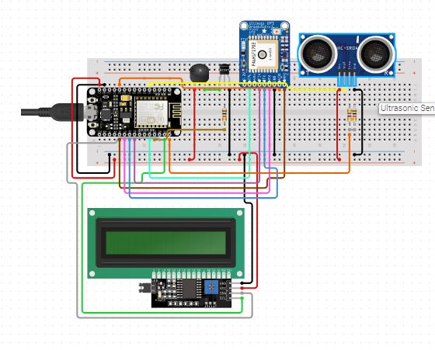
Components and softwares used :
Arduino and GSM/GPS shield
Ultrasonic sensor (to calculate the Height)
Server in the cloud
Desktop application(for data viewing)
Vehicle Routing Algorithm
(picker/collect garbage)

Slide 5
Want to be Change in Future…..!
In here I’m only mention with Desktop Application.
But, The system is need to change as Mobile controlling system.
The change I Want…!
is - Clean and Health…

Slide 6
Phase 2:
Time Mapping....!
Start
4 weeks
Receiving data on the cloud and Processing it (includes Mapping)
Phase 1:
Testing Sensors and implementing with
Arduino and GSM shield
8
weeks
12
weeks
Prototype will be Ready
Phase 3:
Vehicle Routing Algorithm.
Using location system…..

Slide 7
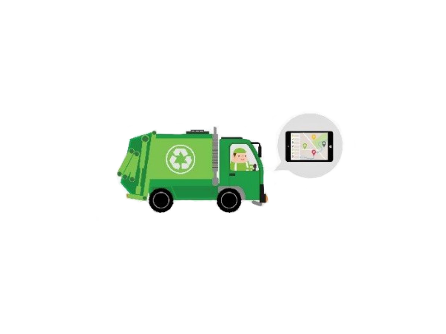
THANK YOU
clean place
clean mind
Be healthy

